Slide 1
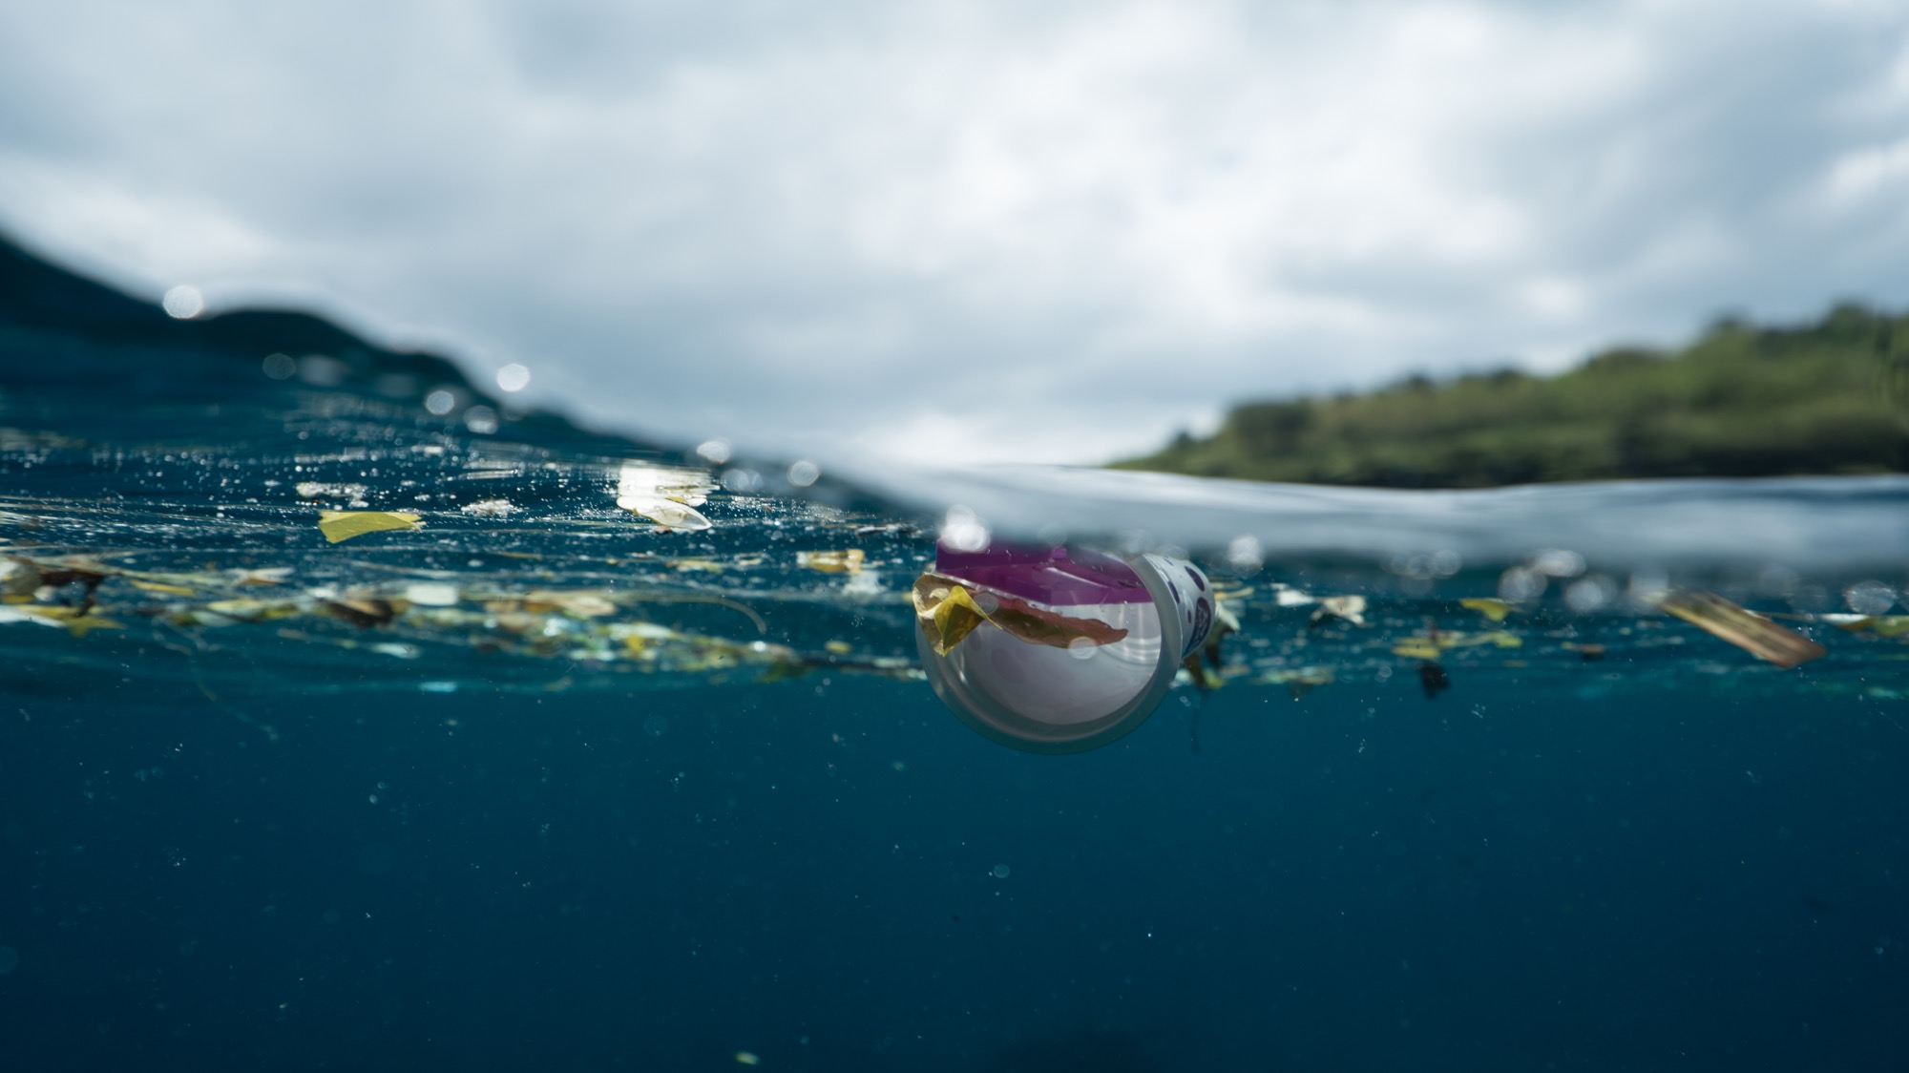
Schools Clean Up Project Spring 2023
https://images.pexels.com/photos/6702766/pexels-photo-6702766.jpeg

Slide 2
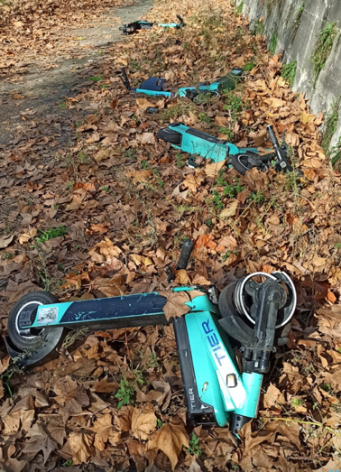
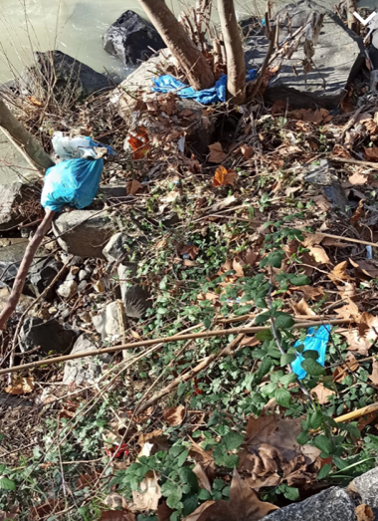
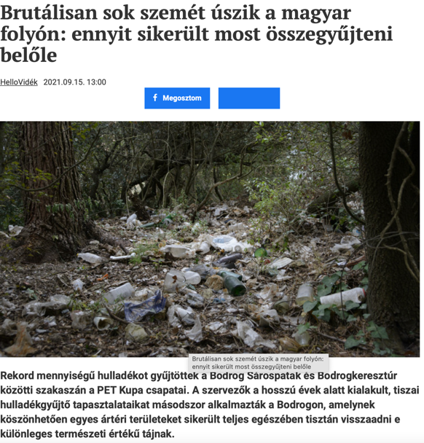
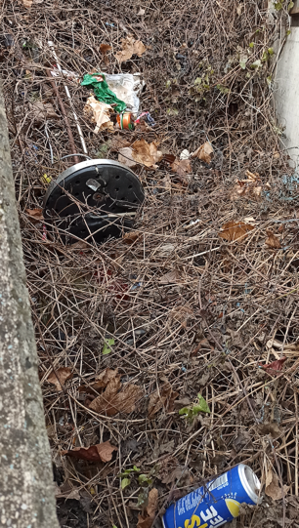
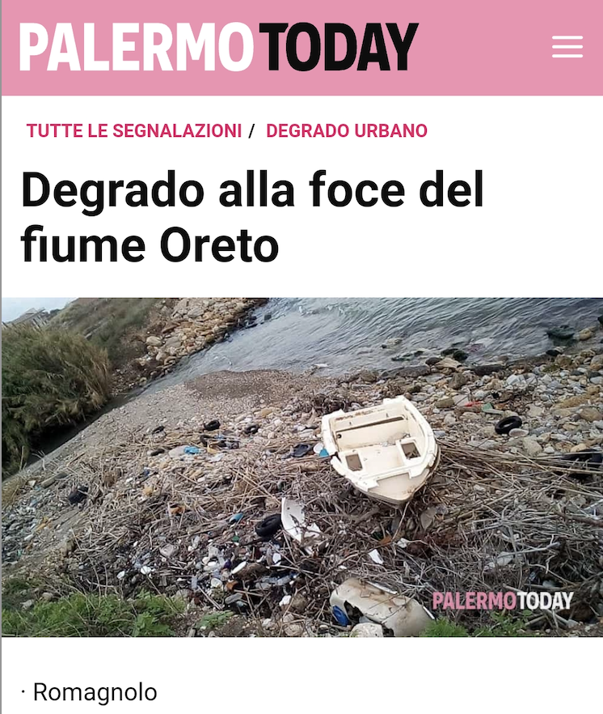
The Problem: Waste, Plastic, Microplastic …
Tevere: Roma, Italy
On our school way,
Vienna, Austria
Tiszai Hungary

Slide 3
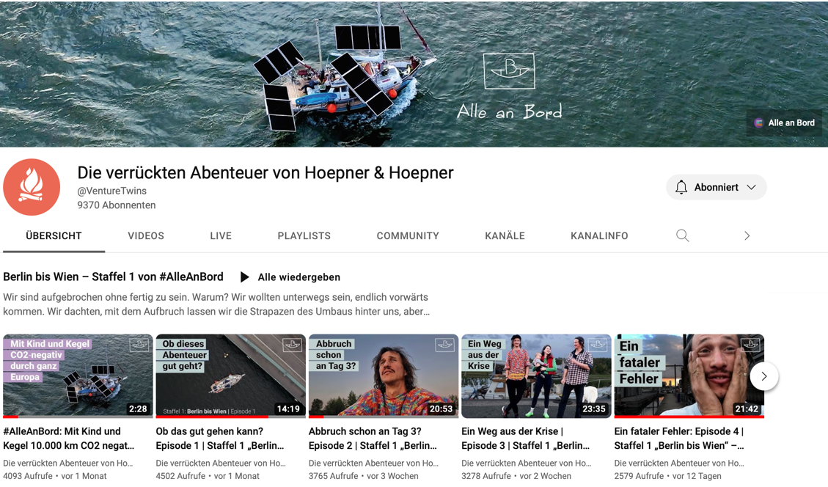
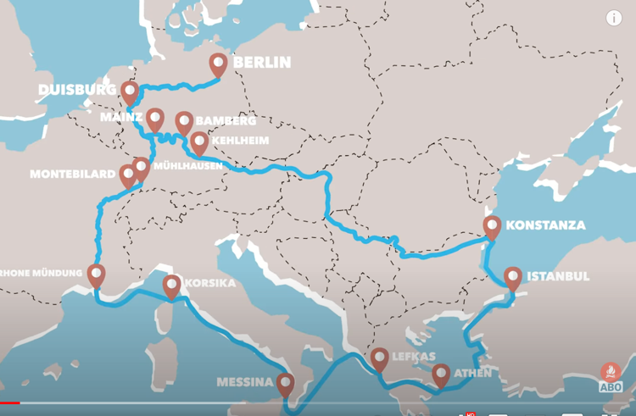
Tour of Höpner & Höpner & VIA & HLTW 13
Project Overview
VIA: SDG Reporting Project
https://forum-via.org/service/sdg-reporter/
The Höpners are 10.000 km on their way through Europe on the mission to identify sustainable projects.
School Project:
HLTW 13 Bergheidengasse Vienna
https://www.bergheidengasse.at
supports by analysing danube water and facilitating Schools Clean Ups in 15 European countries in Spring 2023
with the support of River & Danube Clean up:
https://www.donaucleanup.org/de
https://www.youtube.com/watch?v=tkXqdn3donk&t=31s

Slide 4
Tour of Höpner & Höpner & VIA & HLTW 13
Project Overview
VIA: SDG Reporting Project
https://forum-via.org/service/sdg-reporter/
The Höpners are 10.000 km on their way through Europe on the mission to identify sustainable projects.
School Project:
HLTW 13 Bergheidengasse Vienna
https://www.bergheidengasse.at
supports by analysing danube water and facilitating Schools River Clean Ups in 15 European countries in Spring 2023
with the support of River & Danube Clean up:
https://www.donaucleanup.org/de
https://www.youtube.com/watch?v=tkXqdn3donk&t=31s

Slide 5
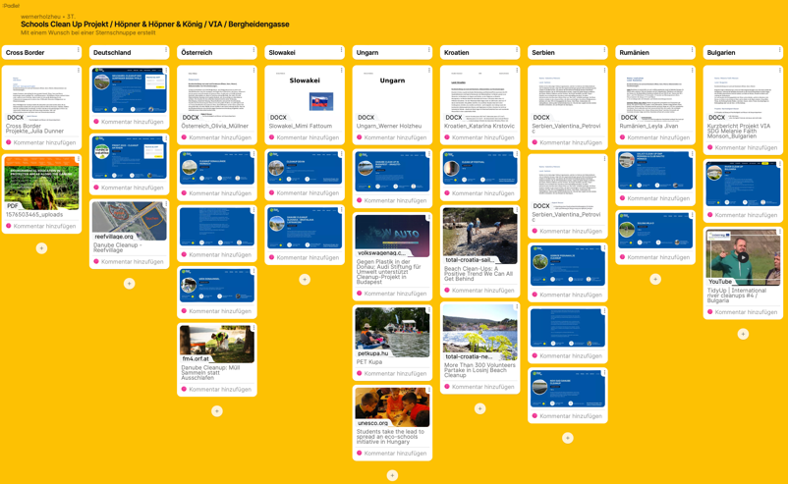
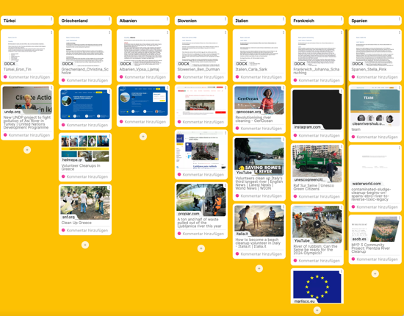
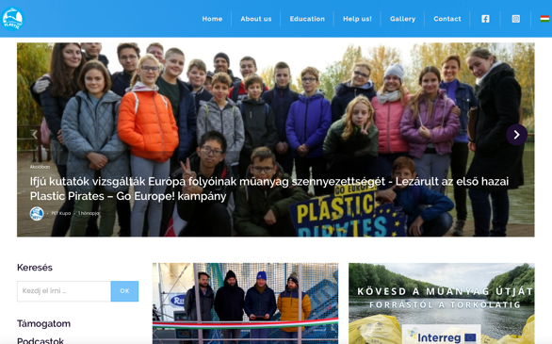
Water Analysis & Project Management Bergheidengasse & EU Parliament Ambassador Project
Water Analysis (2 classes: 2HKC and 1HSB):
Research & Identification of partners & and Schools in EU Countries
(2 classes 4HRD, 4HKC):
https://petkupa.hu/hu_HU/
https://youtu.be/E7qLKZsVIKE
https://youtu.be/KiypBTOCGeU
EU Ambassador School Project (2 classes 4HRD, 4HKC)
https://www.bergheidengasse.at
https://padlet.com/wernerholzheu/iz7gkd3cuoxx9f1v

Slide 6
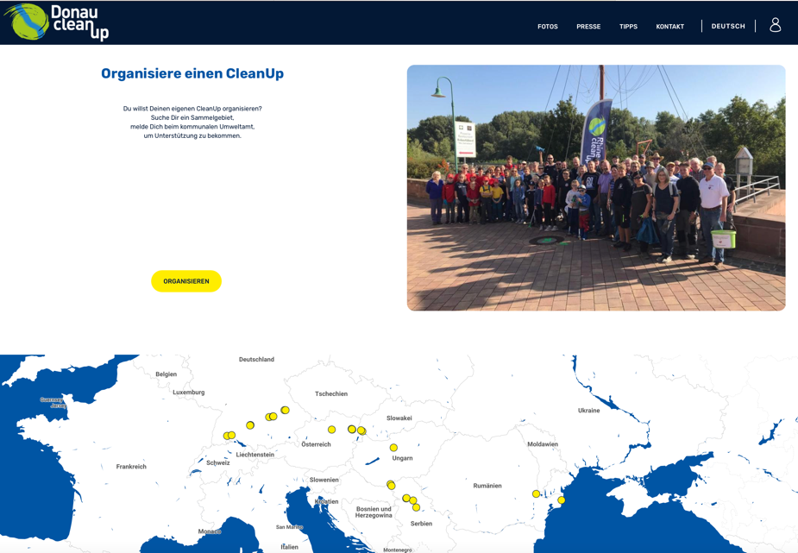
Schools Clean Ups supported by the founding organisations Danube / Rhine Clean Up
https://www.donaucleanup.org/de

Slide 7
Potential Timeline 2023: Schools Clean Up Project
January: Research & Communication
February: Identification and motivation of participating schools
8th or March 1st clean up with 2 Classes (4HKC and 1 HSB) … Green Heroes
March: Identification of spots for clean ups and registration by participating schools, coordination with local waste management organisation (https://www.trashout.ngo/de/home)
April: Get Clean up material from river / danube clean up (gloves, grippers, waste bags)
Bergheidengasse Clean up in cooperation with Danube Clean up … last week of May (100 students)
May & June: Goal at least 15 Clean ups …1 Schools Clean Ups per country and communication on social media
4th – 8th of June 2 Classes of our school > meeting Austrian MP of the European Parliament and present project
Establish annual Schools Clean Up Project

Slide 8
First participating schools (14.2.)
1. Secondary school in Poprad – senior ambassador Ms Iveta Garbinská iveta.garbinska@gmail.com (river POPRAD, near HIGH TATRAS)
2. Secondary school in Komarno – senior ambassador Ms Anita Vlahy vlahyanita@gmail.com (river DANUBE)
3. Secondary school in Dubnica nad Vahom – senior ambassador Ms Daniela Špániková spanikova1daniela@gmail.com (river VAH)
4. Secondary school in Dolny Kubin – senior ambassador Ms Jana Andrisová andrisova@gmail.com (river ORAVA)
5. Sizilien: Giuseppe Riccardo / Palermo (river ORETO)

